Slide 1


How are Motherboards made?
Presentation by Winkler Olivier
1

Slide 2
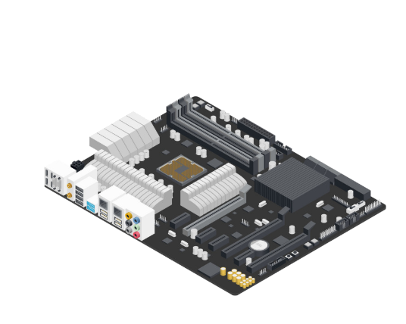
Table of Contents
Why I’ve chosen this topic?
PCB
Layers
What does a Motherboard
Components on the Motherboard
VRM
Capacitors
Resistors
Chokes
MOSFET’s
Motherboard Manufacturing Process
Surface Mount Technology
Dual Inline Package
Testing
Packaging
Questions
2

Slide 3

Why I’ve chosen this topic?
3

Slide 4
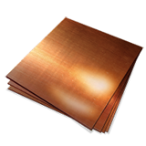

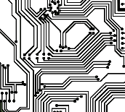

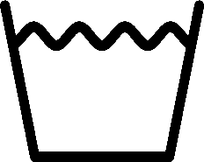

PCB (Printed Circuit Board)
1
2
3
4
5
Fiberglass
Copper
Photoresist
Tracers
UV & Wash
4

Slide 5
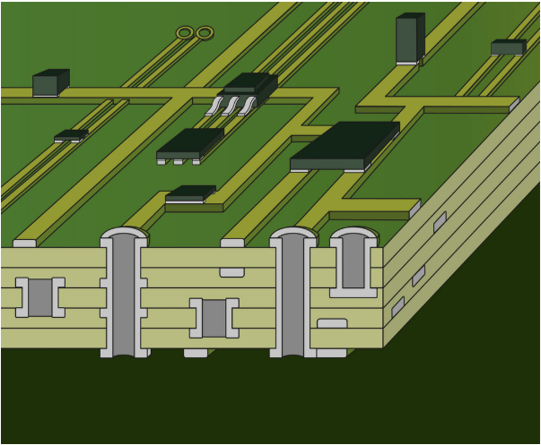
Layers
5

Slide 6
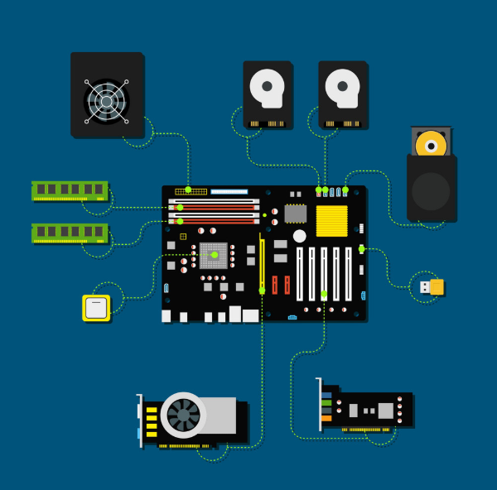
What does a Motherboard?
Connects I/O- & Components
Transmits Data between those Components
BIOS
6

Slide 7
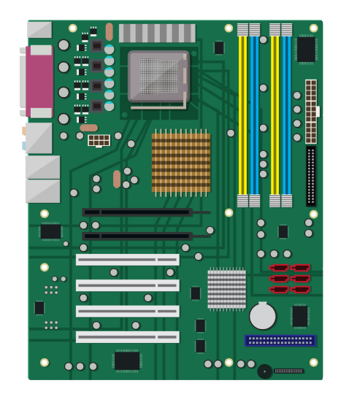
Components on the Motherboard
Processor Socket
Input / Output Connectors
RAM Slots
SATA
PCI Slots
Chipset
BIOS Battery
7

Slide 8
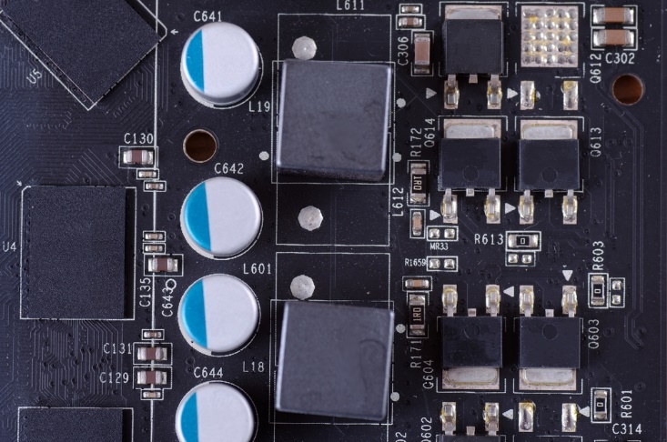
VRM (Voltage Regulator Module)
Capacitors
Chokes
Resistors
MOSFET’s
8

Slide 9
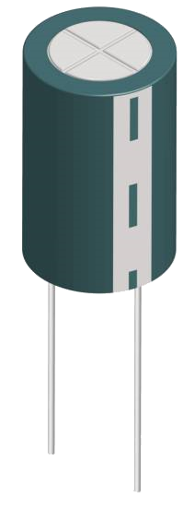
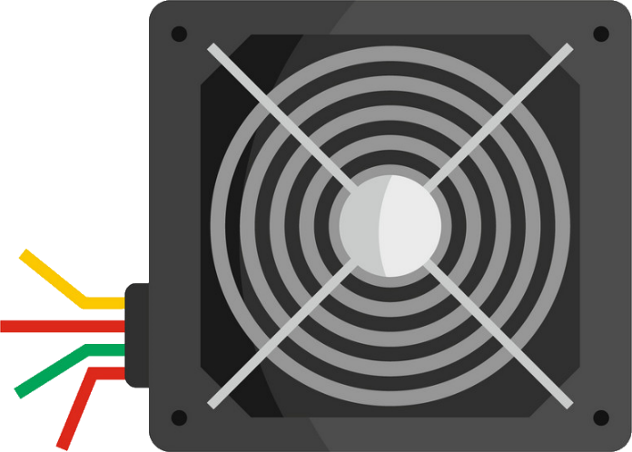


Capacitors
12 Volt
9

Slide 10
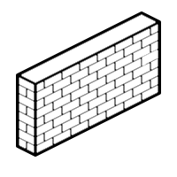
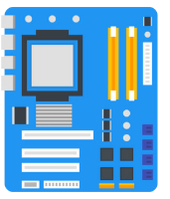

Resistors
10

Slide 11

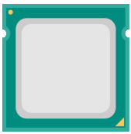
Chokes
11

Slide 12
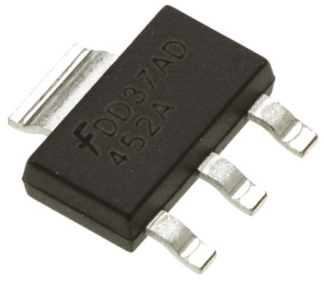
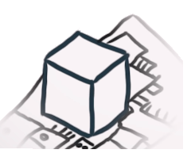

MOSFET’s (Metal Oxide Semiconductor Field Effect Transistor)
12

Slide 13


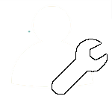

Motherboard Manifacturing Process
Surface Mount Technology
Dual Inline Package
Testing
Packaging
13

Slide 14
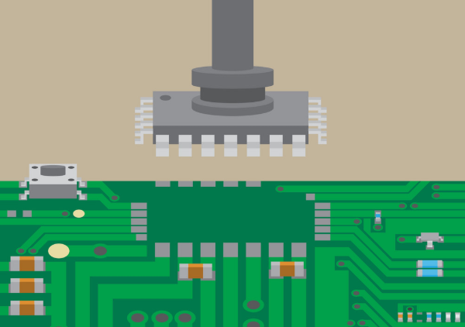
Surface Mount Technology
14

Slide 15
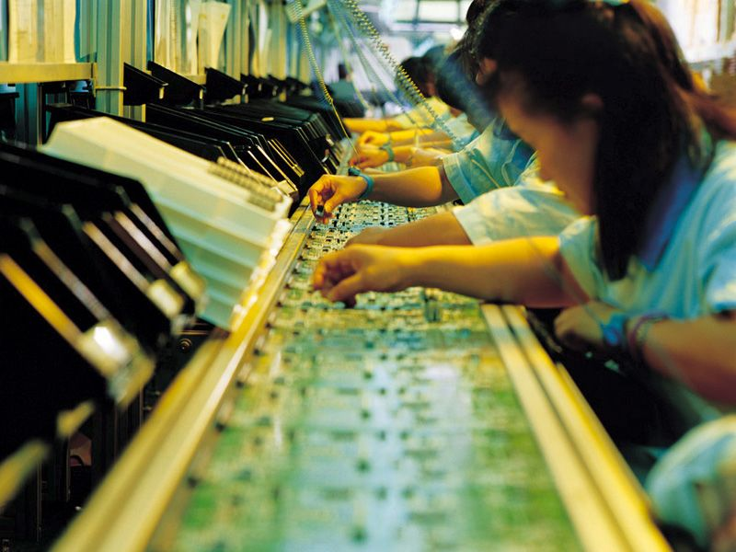
Dual Inline Package
15

Slide 16
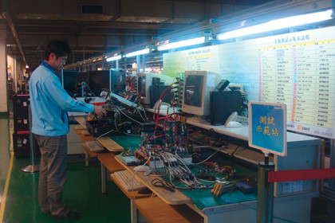
Testing
16

Slide 17
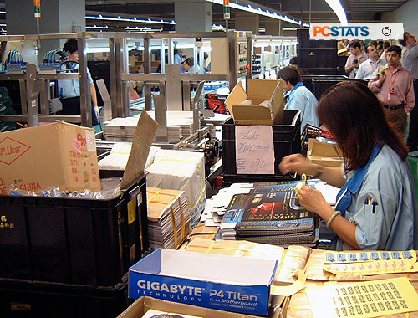
Packaging
17

Slide 18
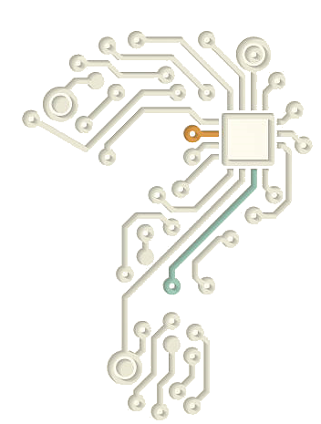
Questions
18

